Slide 1
Open Science policy… and institutional DMP
15. Jun. 2021 - Data Management Planning workshop for Life Science Projects
Dr. lars figenschou University library of UiT,
The arctic university of Norway
Notes:
NRC:
The policy outlines measures related to the following:
• knowledge about and competence in open science
• testing of open science and innovation in projects
• access to and reuse of scientific results
• data infrastructures for handling and making research data accessible
• career development and research assessment
• transparency in research funding processes
• responsible research and innovation
• openness in innovation processes
• rights to research results
• research as the premise for societal development
• involvement of users and the general public in research and innovation processes through user participation and citizen science.

Slide 2
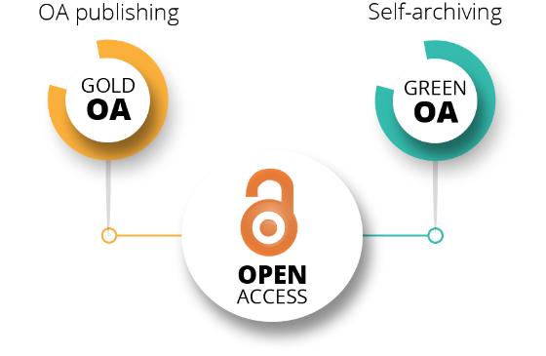
Open Science at UiT
Open Access to articles/books: UiT’s Open Access policy states that researchers shall publish in channels that offer the freest possible access to the publications.
Open research data: All research data shall be made openly accessible. Exceptions to this rule will be when other considerations demand limitations to the access (security, personal privacy, commercial or legal nature). The policy is here.
Open education/teaching/innovations: A new policy on digital learning resources (Jan. 2021 – not official yet)…..
Notes:
Drivkraft i Nord, UiT ambisions: UiT shall be a kind of national leader in Open Science and our research data and publications shall be openly available where possible
1. UiT endorses the principles for research data management of the Research Council of Norway and the EU. 2. Open as standard….default…. and As open as possible, as closed as necessary. 3. All research data shall be made openly accessible. 4. Exceptions to this rule will be when other considerations demand limitations to the access, such as matters of a security, personal privacy, commercial or legal nature. 5. In such cases, this shall be accounted for in the data management plan of the research project

Slide 3
Aims and ambitions for Open Science policy (under Horizon Europe)
EU/Horizon Europe
NRC policies
National authorities
Institutional policies
Researchers (workflow)
FAIR and Open Data should become the default
European Open Science Cloud - store, share, process and reuse
New generation metrics must be developed
Mutual learning exercise on open science - rewards for researchers to engage in open science activities
Future of scholarly communication - scientific publications should be freely accessible)
Rewards - evaluation systems should fully acknowledge open science activities)
Research integrity & reproducibility of scientific results - commonly agreed standards of research integrity
Education and skills - all scientists in Europe should have the necessary skills)
Citizen science - the general public should be able to make significant contributions
Notes:
All governance-levels are stitched together, that is….the policies are related to each other.
Open Data
FAIR and open data sharing should become the default for the results of EU-funded scientific research.
European Open Science Cloud (EOSC)
The (EOSC is a trusted, virtual, federated environment that cuts across borders and scientific disciplines to store, share, process and reuse research digital objects (like publications, data, and software). EOSC brings together institutional, national and European stakeholders, initiatives and infrastructures.
Read more about the EOSC
New generation metrics
New indicators must be developed to complement the conventional indicators for research quality and impact, so as to do justice to open science practices.
Expert group on altmetrics
Mutual learning exercise on open science - altmetrics and rewards
Mutual learning exercises focus on specific research and innovation challenges of interest to several EU countries and associated countries and draw on a hands-on project-based exchange of good practice. This exercise focused on defining.
alternative metrics to measure the qualities and impact of research outcomes
rewards for researchers to engage in open science activities
Read more about this mutual learning exercise
Future of scholarly communication
All peer-reviewed scientific publications should be freely accessible, and the early sharing of different kinds of research outputs should be encouraged.
Read more about open access policy
Rewards
Research career evaluation systems should fully acknowledge open science activities.
A working group in this area produced a report in 2017 on rewards, incentives and recognition for researchers practicing open science
Research integrity & reproducibility of scientific results
All publicly funded research in the EU should adhere to commonly agreed standards of research integrity. The results of Research & Innovation activities should be reproducible. A Scoping Report on the Reproducibility of scientific results in the EU was published in December 2020.
Education and skills
All scientists in Europe should have the necessary skills and support to apply open science research routines and practices.
A working group in this area produced a report in 2017, Providing researchers with the skills and competencies they need to practise Open Science
Citizen science
The general public should be able to make significant contributions and be recognised as valid European science knowledge producers.

Slide 4
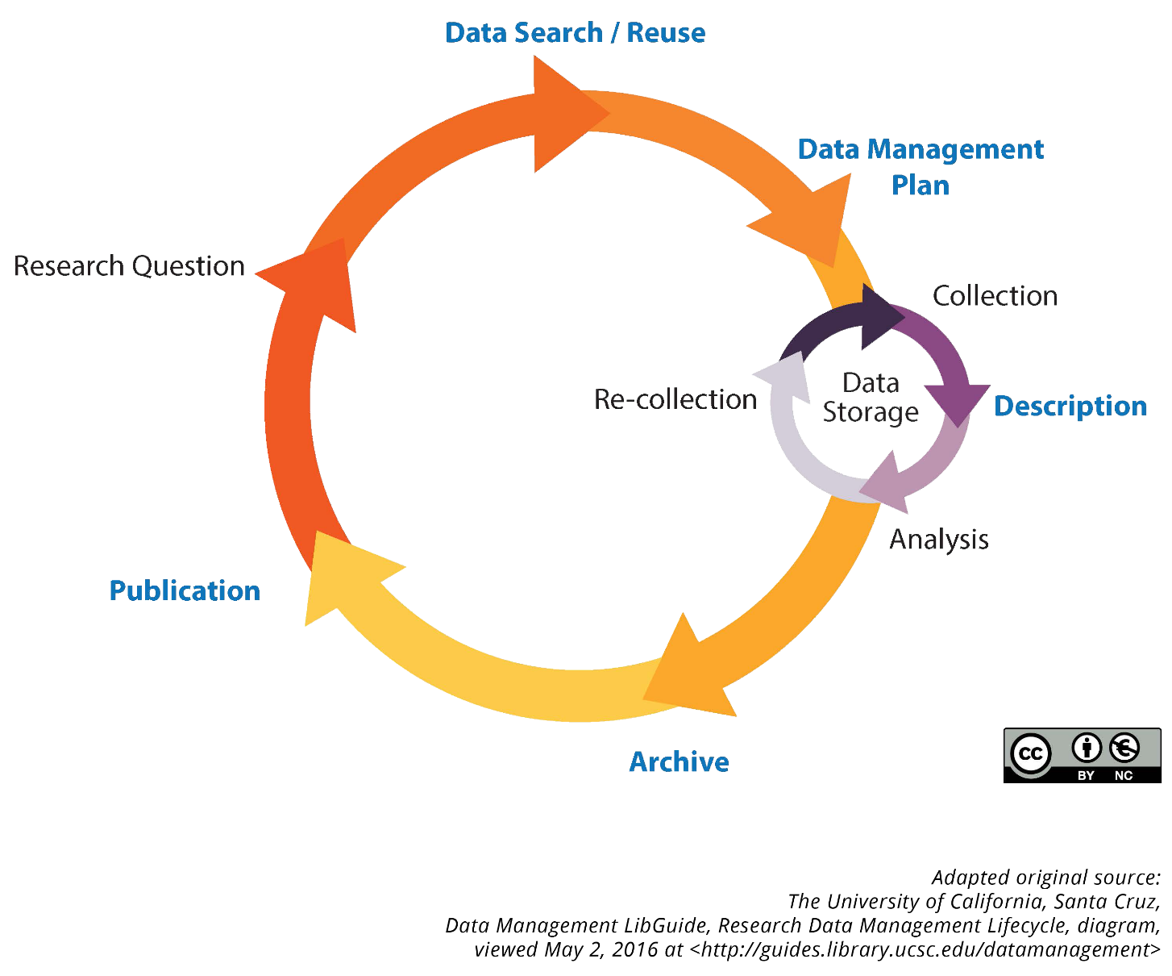
UiT - Data Management Plan
UiT`s DMP policy
A data management plan (DMP)
is plan that documents how you
are going to manage your research
data during and after the project period.
Notes:
It is recommended to follow good practise for research data management in all phases of the research life cycle. A DMP will help you doing so.
Remember… many scientists use to forget that a DMP is an active document:
Yes, you create it before project start, BUT you follow up, and revise it during the project…!
Forskeren (prosjektlederen) skal sette opp en datahåndteringsplan i en tidlig fase av prosjektet og
helst innen seks måneder etter oppstart, om ikke andre frister gjelder hos en prosjektfinansiør.
Datahåndteringsplanen revideres ved behov i løpet av prosjektet. Planen skal si noe om hvordan data
som er vurdert til å ha verdi på lang sikt, skal forvaltes. Forskeren må ha et bevisst forhold til hvordan
forskningsdata som er vurdert til ikke å ha langsiktig verdi skal forvaltes og eventuelt destrueres.
Studenter og deres veiledere skal sikre at forvaltning av forskningsdata er planlagt og dokumentert i
begynnelsen av forskningsprosjektet i form av en databehandlingsplan. Veileder har hovedansvar for å
sikre at forskningsdata finansiert av UiT eller en tredjepart, er overlevert til veileder når studenten
avslutter studiet
Fakultetene/enhetene har ansvar for oppfølging og godkjenning av datahåndteringsplaner og
innpasse dette i rutiner for sine forskningsprosjekter. Fakultetene kan sette egne frister og rammer der
dette vurderes som hensiktsmessig, når disse ikke avviker fra hovedprinsippene.
Universitetsbiblioteket tilbyr støtte til fakultetene/enhetene og deres forskere ved utforming og
godkjenning av datahåndteringsplaner.

Slide 5

Advantages for researcher (1)
First of all : It is a useful tool for you as a researcher
Helps you to keep track on your data throughout the whole project
Planning of everything that has to do with data management
Assures quality of data produced in your project
Assures future re-use of your data
Gives an overview of costs related to data management
Include in your budget when applying for funding!
Helps you to save time and extra work later on
Choose right file formats for archiving from the start
Document and structure your data for archiving from the start
Notes:
Research data is usually an important part of a research project. It pays to make a plan that you have a good overview from the start.
Think of it as a project plan that describes data management through the various phases of the project.

Slide 6
Advantages for researcher (2)
Gives funders, supervisors, colleagues and employer an overview of your plans
Receive feedback and advice
Shows accountability
A good DMP positively influences your project proposal
Helps to make your research data as FAIR as possible

Slide 7
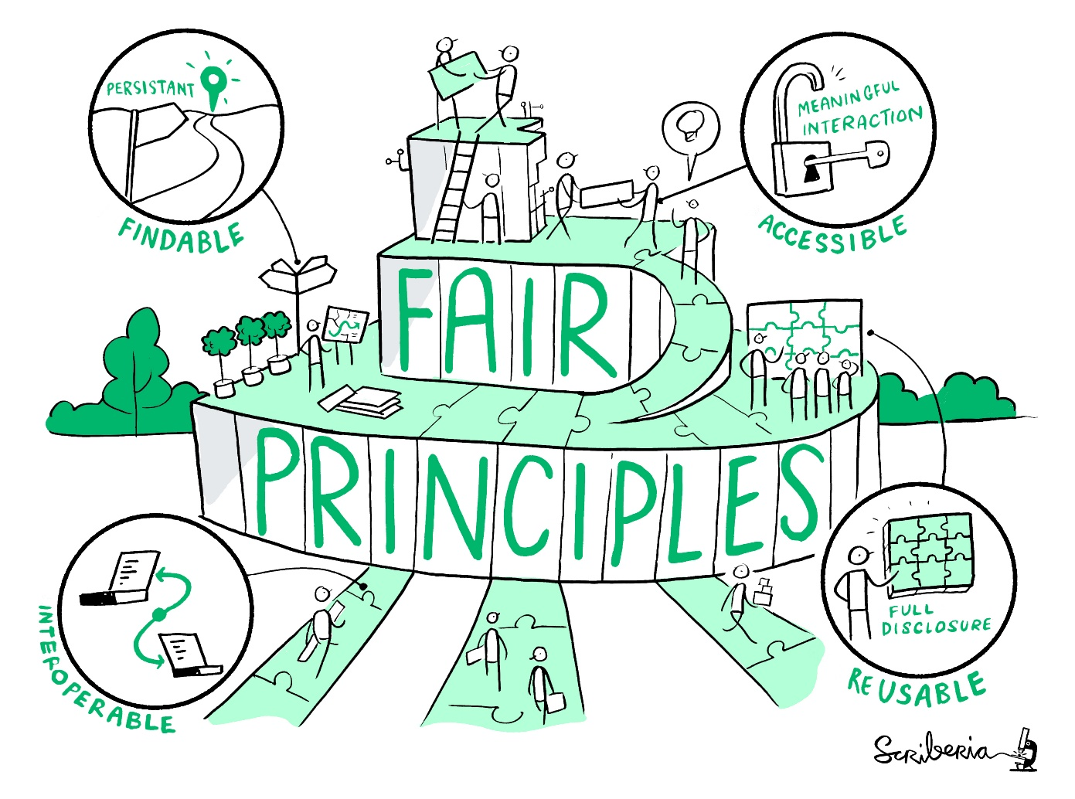
The FAIR Data Principles
Findable Metadata and data should be easy to find for both humans and computers.
Accessible Easy to access – technical aspect
Interoperable To search, compare and process both metadata and data across archives and systems
Reusable Data can be replicated and/or re-used through documentation and user licenses
This image was created by Scriberia for The Turing Way community and is used under a CC-BY licence.
https://doi.org/10.5281/zenodo.3695300
Notes:
When creating a DMP the main goal should be…. to make research data as "FAIR" as possible, i.e. they should be:
Findable
Persistent identifier
Good metadata
Archive indexed in discovery tools
Accessible
Archive with well defined, open protocols
Interoperable
Open and standardized metadata
Persistent file formats
Re-usable
Well documented data
Clear user license

Slide 8
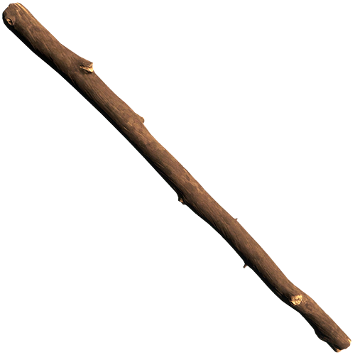



Main requirements from UiT (and funders)
UiT
The researcher shall write a DMP in an early phase of the project and preferably within six months of the start of the project.
Principles and guidelines for research data management at UiT
RCN
The management of research data must be described in a DMP.
RCN’s policy for Open Access to research data
ERC
A first version of a DMP should be submitted within the first 6 months of the project
Horizon 2020, Online Manual. Data Management
Notes:
UiT
cf. “Principles and guidelines for research data management at UiT” (September 1, 2017)
The data management plan may be revised if needed in the course of the project.
This plan shall describe how data assessed as being of long-term value will be managed.
The Research Council of Norway (NFR)
The plan should comply with the FAIR principles.
DMPs should be public and made openly accessible.
The final DMP should be submitted with the project’s end report
European research council (ERC)
“Data Management Plans (DMPs) are a key element of good data management”
The DMP needs to be updated over the course of the project whenever significant changes arise
Any questions so far on these requirements? Or on anything else?

Slide 9
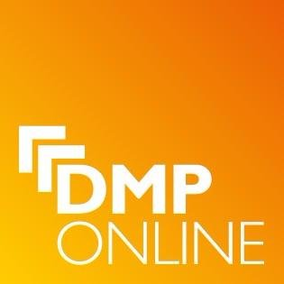
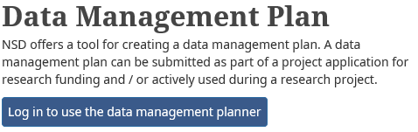
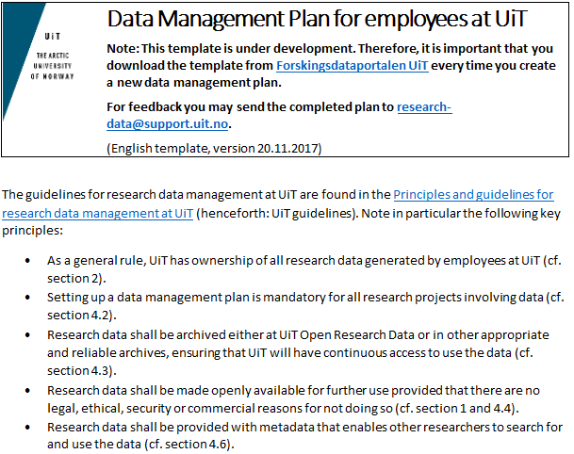
Templates for DMPs
Project subject to notification to NSD:
NSD template
Project funded by EU:
DMPonline
All other projects:
UiT template

Slide 10
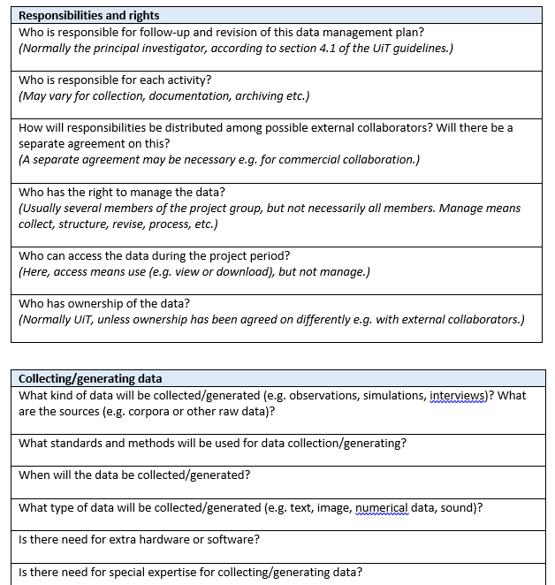
Templates for DMPs
UiT template explains most aspects in more detail
Notes:
Forskeren (prosjektlederen) skal sette opp en datahåndteringsplan i en tidlig fase av prosjektet og
helst innen seks måneder etter oppstart, om ikke andre frister gjelder hos en prosjektfinansiør.
Datahåndteringsplanen revideres ved behov i løpet av prosjektet. Planen skal si noe om hvordan data
som er vurdert til å ha verdi på lang sikt, skal forvaltes. Forskeren må ha et bevisst forhold til hvordan
forskningsdata som er vurdert til ikke å ha langsiktig verdi skal forvaltes og eventuelt destrueres.
Studenter og deres veiledere skal sikre at forvaltning av forskningsdata er planlagt og dokumentert i
begynnelsen av forskningsprosjektet i form av en databehandlingsplan. Veileder har hovedansvar for å
sikre at forskningsdata finansiert av UiT eller en tredjepart, er overlevert til veileder når studenten
avslutter studiet
Fakultetene/enhetene har ansvar for oppfølging og godkjenning av datahåndteringsplaner og
innpasse dette i rutiner for sine forskningsprosjekter. Fakultetene kan sette egne frister og rammer der
dette vurderes som hensiktsmessig, når disse ikke avviker fra hovedprinsippene.
Universitetsbiblioteket tilbyr støtte til fakultetene/enhetene og deres forskere ved utforming og
godkjenning av datahåndteringsplaner.

Slide 11
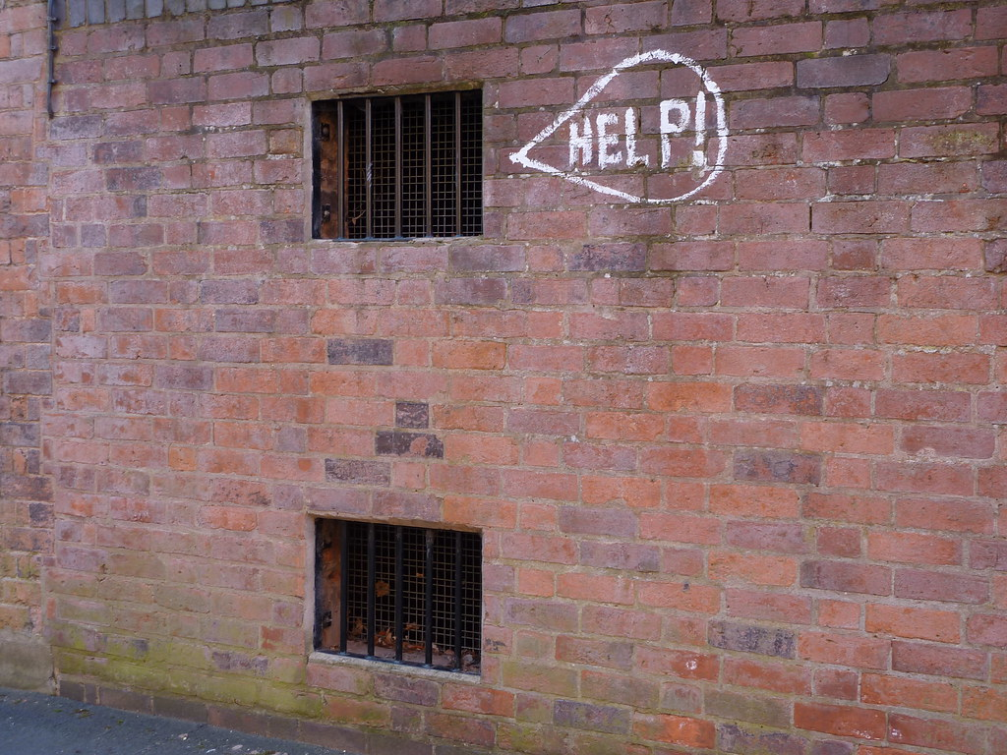
More information and help
UiT Research Data Portal:
http://uit.no/researchdata
DMP template
Principles and guidelines for research data management
Tips
Overview of webinars/courses
Research data management training
https://site.uit.no/rdmtraining/
Email:
researchdata@hjelp.uit.no
"Help!" by lydia_shiningbrightly is licensed under CC BY 2.0

Slide 12

What should be included in a DMP?
All phases in the RDM lifecycle
Data re-use
Data collection
Data storage
Archiving and sharing
Other aspects:
General information about the project
Responsibilities and rights
Documentation and metadata
Ethics and consent
Keep in mind:
UiTs guidelines for RDM
FAIR Data Principles
F
A
I
R
Notes:
Mention difference between storage and archiving
Storage = active phase
Archiving = long term preservation

Slide 13
General information about the research project
Project number and name
Project period
Description of project
Part of a larger research project?
Funding
Project leader and participants (name and institution)

Slide 14
Responsibilities and rights
Who is responsible for follow-up and revision of the DMP?
UiT guidelines: The project leader
PhD-project part of a larger research project:
the project leader is responsible for the DMP of the entire project
the PhD student shall also write their own DMP for their part of the project (§11.4 in PhD regulations for UiT)
Who has ownership of the data?
UiT guidelines: UiT: unless something else is agreed upon
External collaborators?
Division of responsibilities and rights
Who has right to manage the data? Collect, structure, revision, processing, etc
Who can access the data during the project? Use (view or download), but not manage
Own webinar on «Research data and agreements»
Notes:
Division of responsibilities and rights
Will there be a separate agreement on this? A separate agreement may be necessary e.g. for commercial collaboration.

Slide 15
Planning phase : Data re-use
Are there data in this subject already…? What are the possibilities for reuse?
Places to search:
DataCite
BASE
Google Dataset Search
Registry of research data repositories
Webinar at UiT on «How to search and cite research data»
Notes:
Re-use of data is important. You can build your work further upon what others have been doing before you. By doing so you will not re-invent the wheel and safe resources. Searching for data might provide you valuable input on how to plan your own experiments and might allow you to plan and improve your methodology. Things to keep in mind when writing a DMP:
Are there data in this subject already and what are the possibilities for reuse?
Your own data, data from within your research group or network, or data archived in a repository

Slide 16
Active phase: Data collecting
When will the data be collected / generated?
What kind of data will be collected/generated?
E.g., observations, simulations, interview, text, image, numerical data, sound, etc
What standards and methods will be used?
Description can be reused during publishing of related article and archiving of data
Need for extra hardware or software? Need for special expertise?
In that case: Need for funding?
Notes:
Data collection or generation is important for the quality of your research. It is also time consuming and often expensive. It is therefore important that you plan accurately. Things to keep in mind when writing a DMP:

Slide 17
Active phase: Data storage
What are the procedures for storage and backup, and where will this be done?
The IT Department is responsible for data backup provided that UiT facilities are used for storage
What are the expected file sizes for the data?
Do you have sufficient storage possibilities or need for extra services?
Think budget
Own webinar on «How to store research data»
Notes:
When you are collecting data, it is important to store it in a safe and secure way to prevent data loss. Things to keep in mind when writing a DMP:

Slide 18
Active phase: Data storage in the field
What are the procedures for safe data storage and backup in the field?
How will the data be safely transferred from the field to the main storage facility?
Recording something?
What medium will you use?
Approved for your kind of data?
Person sensitive information?
Contact IT department for advice
e.g. encrypted USBs, active storage TSD
Own webinar on «How to store research data»
Notes:
How will the data be safely transferred from the field to the main storage facility?
Do you have sufficient storage and transfer possibilities?
Are you recording something?
What medium will you use?
Approved for your kind of data?
Are you conducting interviews with person sensitive information?
Contact IT department for advice (e.g. encrypted USBs)!
Apps for safe storage of interview data directly to TSD (service for sensitive data)
Own webinar on «How to store research data»

Slide 19
Active phase: Data documentation
How will the data be documented and described?
ReadMe file
Metadata (standards)
What file formats will be used?
Persistent file formats
What kind of folder structure and filename conventions will be used?
See UiT Open Research Data deposit guidelines for tips and templates
Own webinar on «How to structure and document research data»
F
I
R
I
Notes:
In order for other researchers to be able to understand and reuse your data, it is essential that you describe them in a comprehensible and consistent manner before they are published. Things to keep in mind when writing a DMP:
How will the data be documented?
A ReadMe file is a more detailed user guide to your dataset so that other researchers are able to interpret, understand, and reuse your data, including information about how the dataset was created, how complete it is, and what kind of restrictions it has.
Metadata is information about your data which makes them findable in discovery services. Some academic fields have established metadata standards, whereas other fields do not. Examine best practice in your field. Have a look at what type of metadata is common in the archive you are going to publish your data in

Slide 20
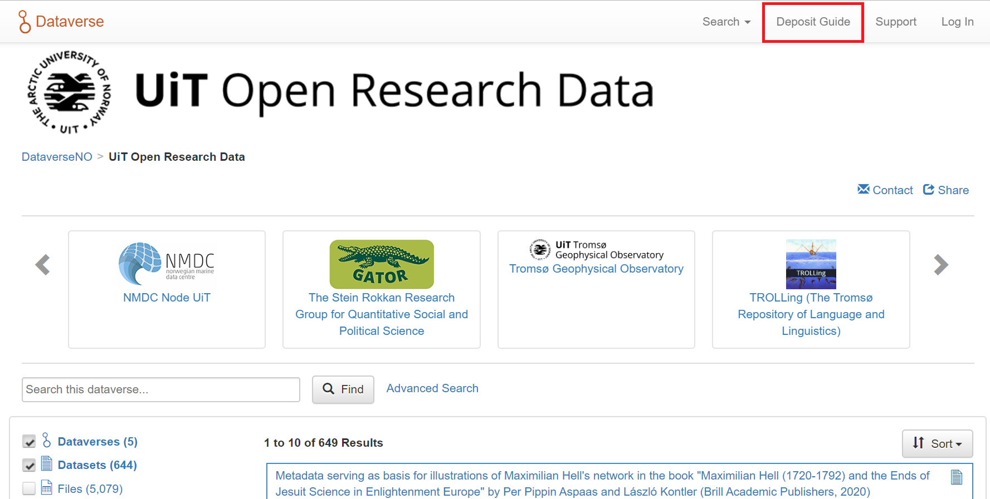
opendata.uit.no
Notes:
Any questions so far?

Slide 21
Archiving phase: Archiving and sharing (1)
Which data will be (long term) preserved and which will be destroyed?
Will the data or a selection of the data be openly shared?
UiT guidelines: Research data shall be made openly available for further use provided that there are no legal, ethical, security or commercial reasons for not doing so
If yes: which data?
If no: what is the reason?
Do the data need processing before they can be shared?
Anonymization, convertion to persistent file formats.
Own webinar on «How to share research data»
Notes:
Archiving and sharing data is not only required by the funders and UiT, it also gives you a lot of benefits. You will make your work visible and citeable by sharing. Sharing data also contributes to the transparency of science. Things to keep in mind when writing a DMP:
Which data will be (long term) preserved and which will be destroyed?
UiT guidelines, researchers have to assess the long-term value of their data, and describe how they will be managed

Slide 22
Archiving phase: Archiving and sharing (2)
Where will the data be archived?
UiT guidelines: A reliable open archive, ensuring that UiT will have continuous access to use the data
UiT Open Research Data or find a repository at re3data.org
When will the data be made openly available?
UiT guidelines: As early as possible
How will the data be licensed for reuse?
UiT guidelines: As few limitations on the data as possible
Are there other conditions, restrictions or embargo on use?
Own webinar on «Rights and licenses»
A
R
F
R
Notes:
Where will data, metadata, documentation and code associated with the data be archived?
UiT’s archive for open research data, UiT Open Research Data, provides researchers with a safe service for archiving, sharing and publishing open research data.)
When will the data be made openly available?
For data that form the basis of scientific publications, this means no later than the date of publication.
For other data that may be of interest for other research, this will normally be at the end of the project and no later than three years after the project has ended.
How will the data be licensed for reuse?
UiT guidelines, research data shall be equipped with licenses for access, reuse, and dissemination.

Slide 23
Ethics and consent
Special rules for personal sensitive data, e.g. consent, protection of participant identity
Get consent for archiving and re-use of data:
https://nsd.no/personvernombud/en/help/information_consent/index.html
Contact NSD and personvernombud at UiT: Joakim Bakkevold (personvernombud@uit.no)
Ethics Portal UiT: http://uit.no/etikk
Notes:
NSD = Norwegian Centre for Research data

Slide 24
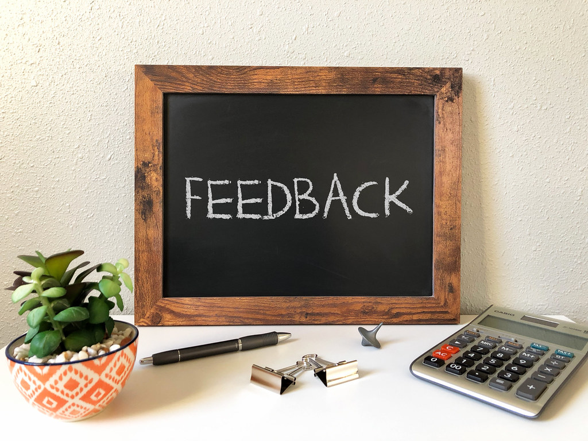
Feedback on DMP?
University library can check if your DMP is in line with the guidelines and «best-practice» recommendations
Send your DMP to researchdata@hjelp.uit.no for feedback.
Request: Give us time to help you! Don’t send your DMP the evening before your deadline ☺
"Feedback" by Got Credit is licensed under CC BY 2.0

Slide 25
Examples of DMPs
DMPOnline: https://dmponline.dcc.ac.uk/public_plans
DMPTool: https://dmptool.org/public_plans
CESSDA – qualitative data: https://www.cessda.eu/content/download/3536/33233/file/DMPQuestionsQualitativeData.pdf
CESSDA – quantitative data:
https://www.cessda.eu/content/download/3537/33238/file/DMPQuestionsQuantitativeData.pdf

Slide 26
More information and help
UiT Research Data Portal:
http://uit.no/researchdata
DMP template
Principles and guidelines for research data management
Tips
Overview of webinars/courses
Research data management training
https://site.uit.no/rdmtraining/
Email:
researchdata@hjelp.uit.no
"Help!" by lydia_shiningbrightly is licensed under CC BY 2.0

Slide 27
Guidelines to follow-up on DMP at UiT
PhD projects are followed up in connection to progress meetings
Externally funded projects are followed up in connection to approval routines for externally funded projects
For other types of research projects: No policy has been introduced to follow up on the research of individual employees. The management has asked the faculties to follow up on their researchers regarding their DMP.

